Slide 1


Slide 2
Good Morning, London

Slide 3

AgentCon around the world

Slide 4
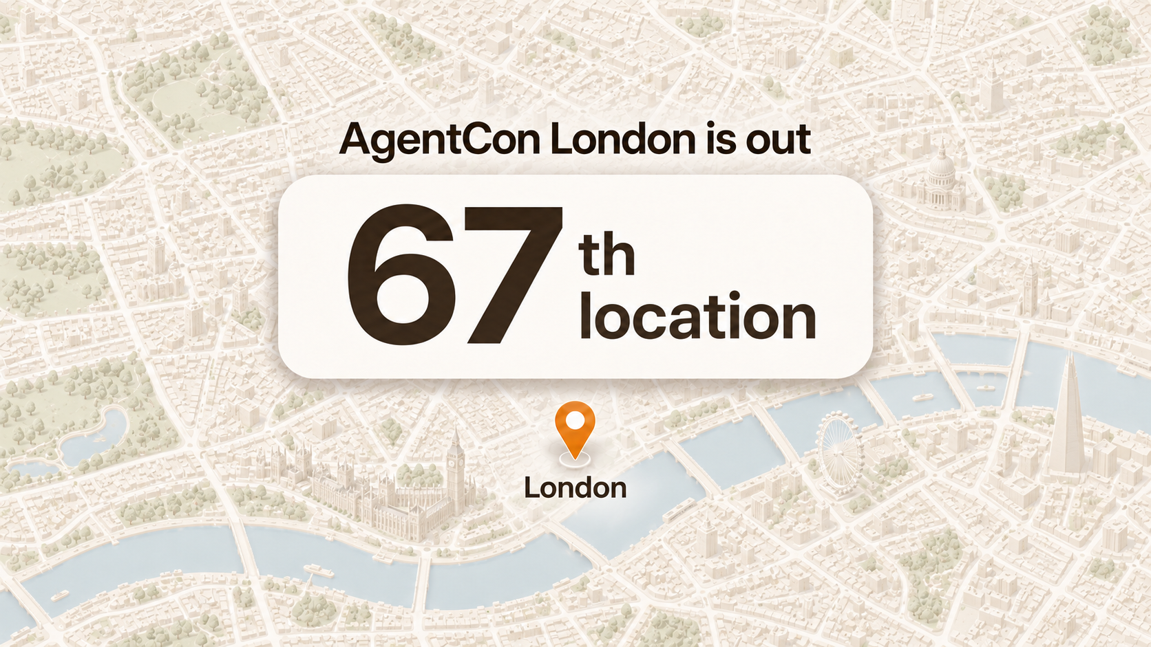

Slide 5
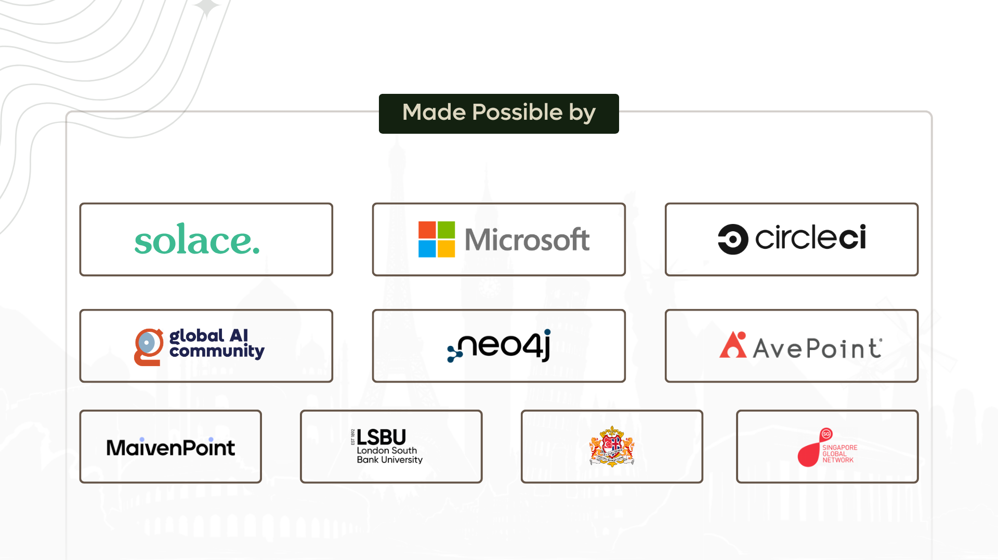

Slide 6
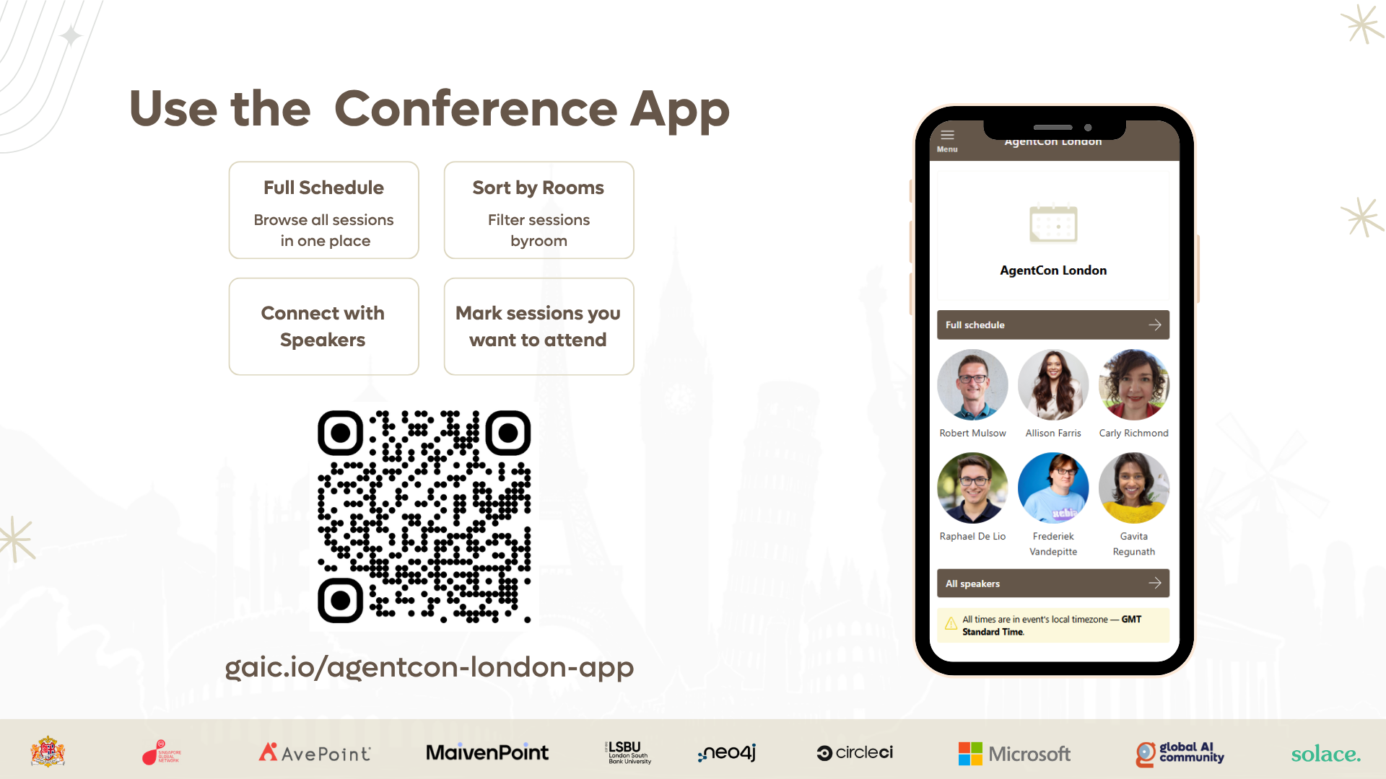

Slide 7
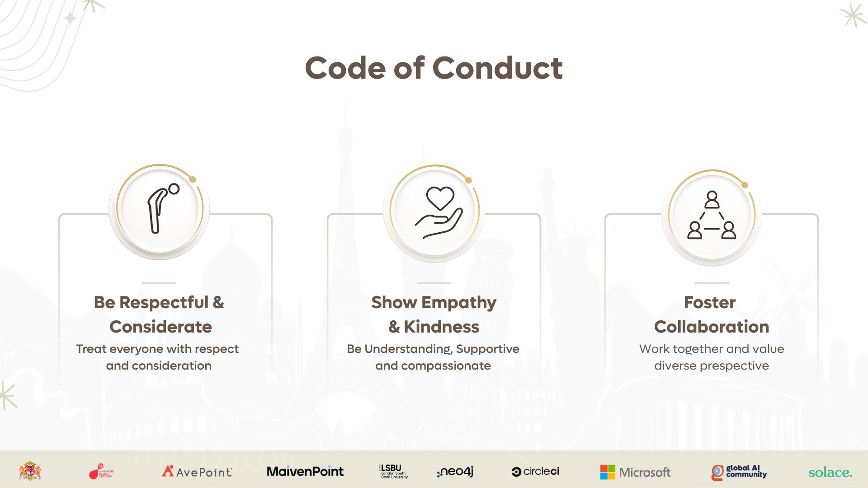

Slide 8

Join the AI Conversation on Discord
gaic.io/discord

